Slide 1
APPLICATIONS OF AI IN HEALTH AND MEDICINE Diabetes Prediction
Team Data Pirates
Radhika Gopalakrishnan Nair (U2255224)
Lisat Kalathoor Mathew (U2263800)
Gracile Astlin Pereira (U2292824)
Blosom Ann Jose (U2270400)
Jewel Anns (U2262339)

Slide 2
INTRODUCTION
Diabetes is a severe chronic disease that impairs a person's capacity to control blood glucose levels characterized by insufficient insulin production or insufficient ability to utilize the insulin that is produced.
Complications like heart disease, lower-limb amputation, retinopathy, neuropathy, gestational diabetes mellitus (GDM), hypoglycemia, nephropathy, are associated with chronically high levels of sugar remaining in the bloodstream for those with diabetes.
Artificial intelligence (AI) can draw sophisticated conclusions based on the enormous data available.

Slide 3
The literature review conducted suggests the research gap in the use of AI techniques in the accurate diagnosis of diabetes and its complications.
As per an article published in Diabetes UK, it is estimated that 4.8 million people in the UK have diabetes which accounts for 6% of the UK population. While type 2 diabetes accounts for 90% of all cases, approximately only 10% of the population suffers from type 1 diabetes.
The main aim of case study is to train supervised machine learning(ML) models in order to predict diabetes and compare the accuracy score to find the best fit model.

Slide 4
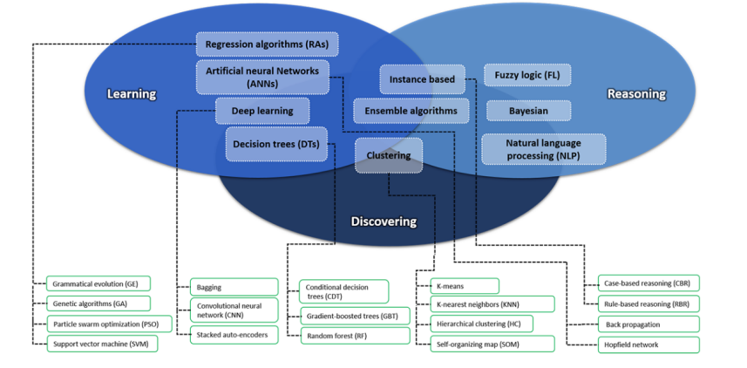
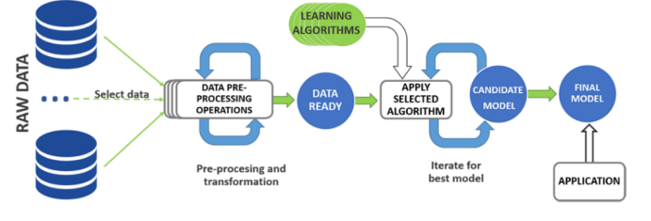
TAXONOMY OF AI BEST METHODS
Learning Algorithm Process

Slide 5
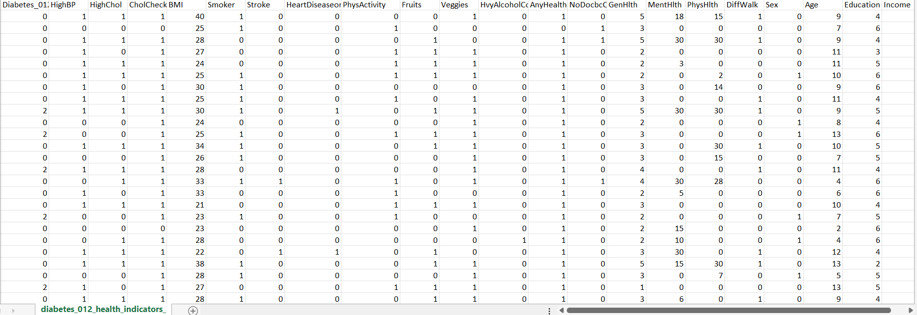
DATASET
The dataset is collected in 2015 through a health-related survey conducted by Behavioral Risk Factor Surveillance System (BRFSS) by the Centers for Disease Control and Prevention (CDC).
The dataset has the main file, diabetes_012_health_indicators_BRFSS2015.csv.
253680 records of data
21 feature variables
Dependent variable - 'Diabetic_012' - which has three categories 0,1 and 2 indicates No diabetes, Pre-diabetes and Diabetes respectively

Slide 6
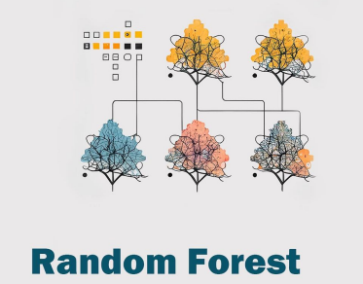
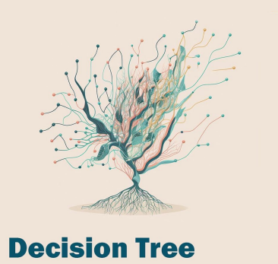
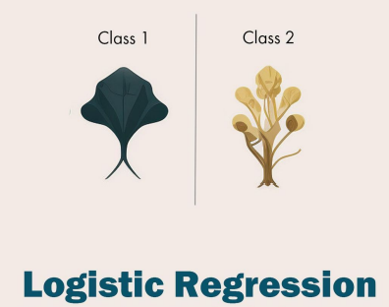
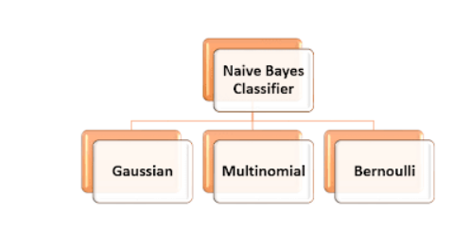
PLATFORMS,PACKAGES,ML MODELS
Platform : Project Jupiter
Packages
Pandas
Numpy
Matplotlib
Seaborn
Sklearn
Imblearn
ML Models
Random Forest
Decision Tree
Logistic Regression
Naïve Bayes Classifier

Slide 7
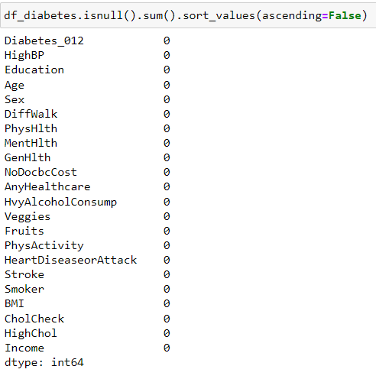
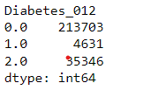

DATA PRE-PROCESSING
Find out if any missing value for any of the features
Create new dataframe combining Pre-Diabetes and diabetes together to make the dependent feature binary.
0 - Nondiabetic, 1 – Diabetic

Slide 8
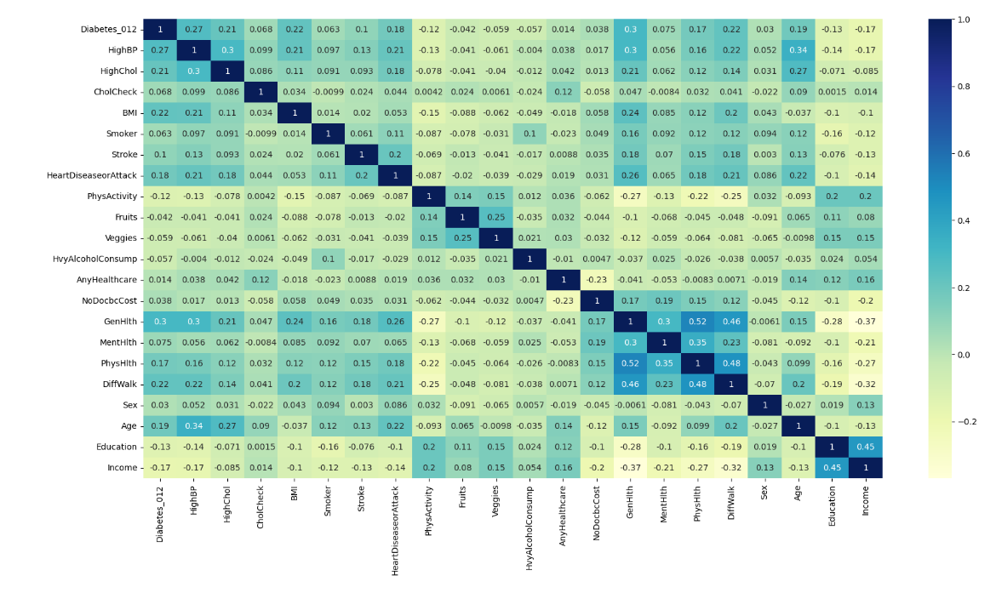
DATA PRE-PROCESSING
Select the most correlated features for diabetes prediction
Remove the independent features which has less correlation with dependent variable
Keep the least correlated independent variables
for prediction.

Slide 9
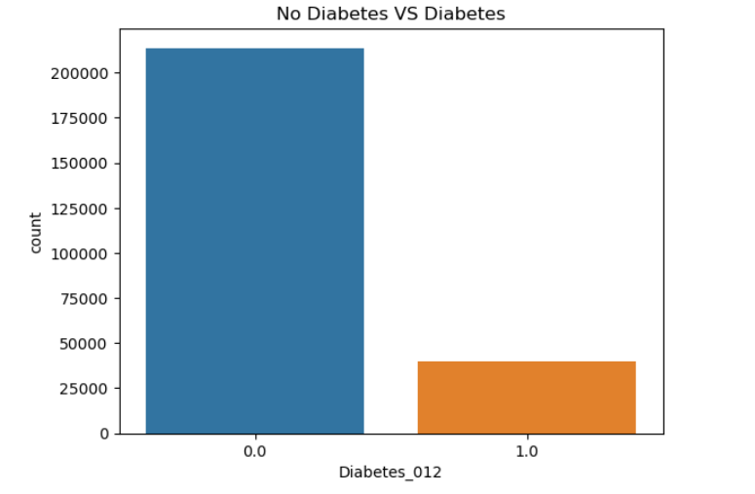
DATA PRE-PROCESSING
Check if data is balanced
Apply balancing techniques [imbalanced learn ]
Over sampling
Under sampling
Split data to train and test dataset
80% of data to train
20% data to test

Slide 10
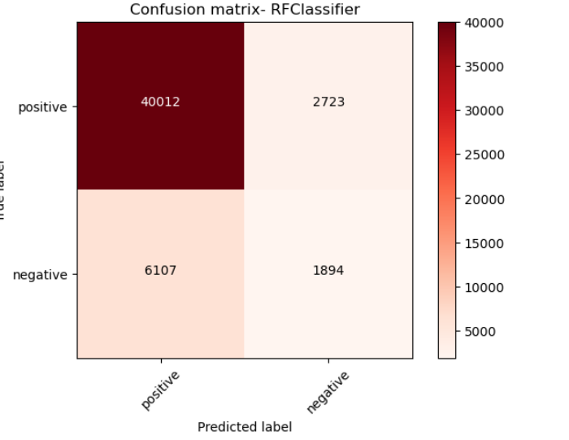
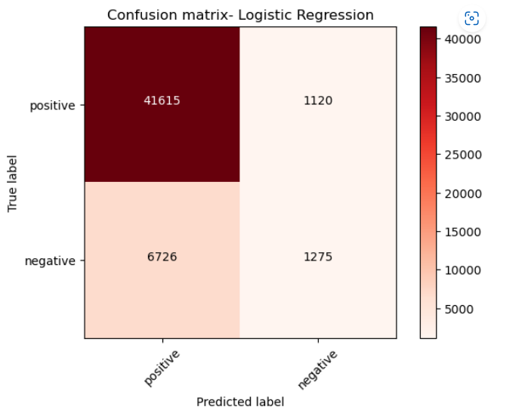
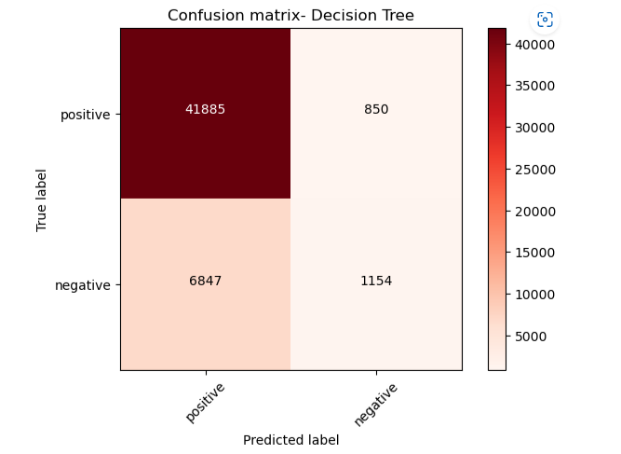
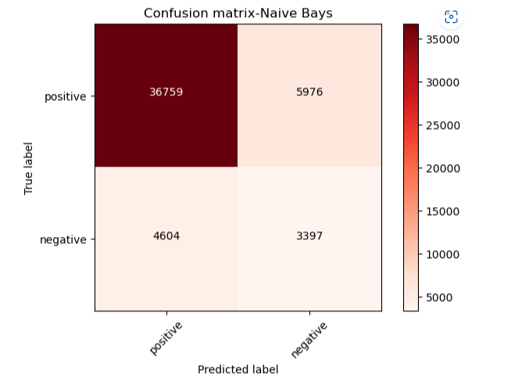

IMPLEMENT ML MODEL [Under Sample]
Under samples the majority class in the input data to balance the dataset
Train ML models on the training data
Predicts the target variable using the ML models chosen on the test data
Calculate the accuracy of prediction for each model and compare

Slide 11
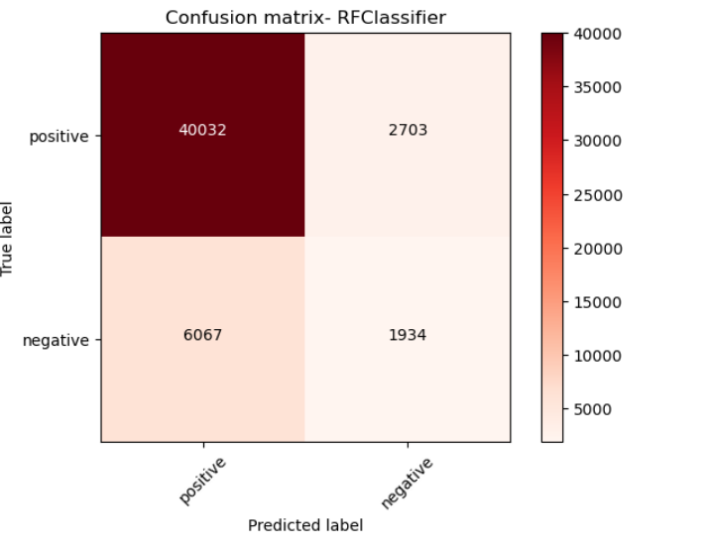
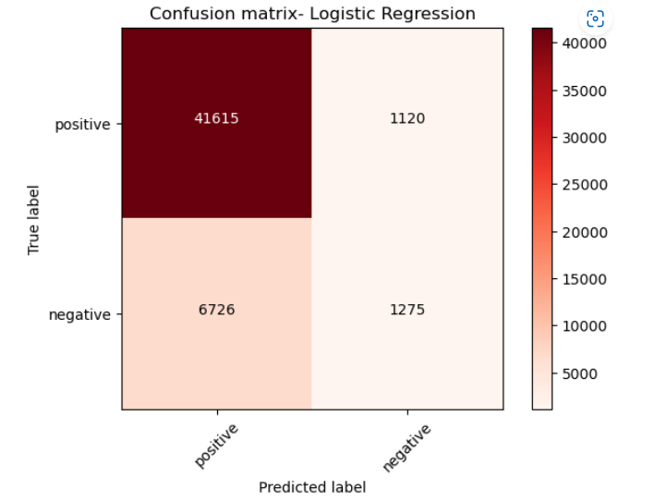
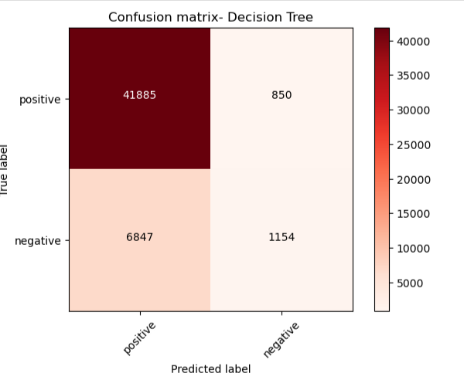
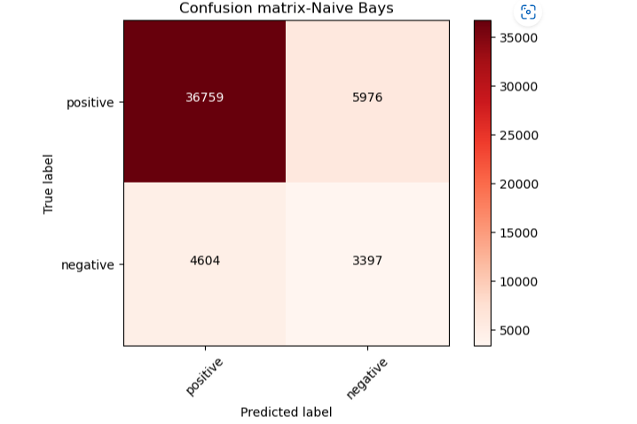

IMPLEMENT ML MODEL [Over Sample]
Over samples the minority class in the input data to balance the dataset
Train ML models on the training data
Predicts the target variable using the ML models chosen on the test data
Calculate the accuracy of prediction for each model and compare

Slide 12
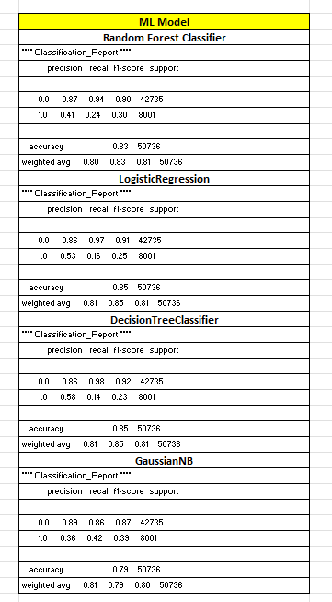
CLASSIFICATION REPORT
The weighted average F1-score is equal or above 0.80, which is a decent score
The low precision and recall for the positive class suggest that the models may not be performing well on the positive class

Slide 13
CONCLUSION
In general, the accuracy scores are quite high, ranging from 0.79 to 0.85, but the precision, recall, and F1-score metrics show some variation.
Based on the accuracy comparison, it appears that the Logistic Regression, Decision Tree Classifier, and Random Forest Classifier are all effective models for the given data set. These models have accuracy scores of 0.845, 0.848, and 0.825 respectively. The Gaussian Naive Bayes model has a slightly lower accuracy of 0.791.
The model needs to be improved or that the class imbalance needs to be addressed in future studies.

Slide 14
REFERENCES
Dataset
https://www.kaggle.com/datasets/alexteboul/diabetes-health-indicators-dataset
Statistics
https://www.diabetes.co.uk/diabetes-prevalence.html

